Slide 1

Using features extracted by CNN methods for image classification with machine learning methods
Dr.Abdi, IUST, Summer 2022
Presenting by Amirhossein Aminimehr

Slide 2
Table Of Contents
Introduction
Dataset
Convolutional Neural Networks (CNN)
VGG
GoogLeNet (Inception)
ResNet
Machine Learning methods
Naïve Bayes
Decision Tree
SVM

Slide 3
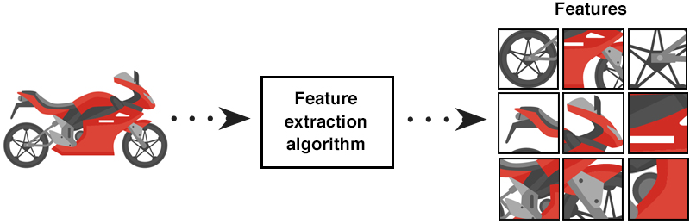
Introduction
Classification task
Feature extraction
Based on task
Neural Networks
Dense Neural Network
Convolutional Neural Network
Image Classification

Slide 4
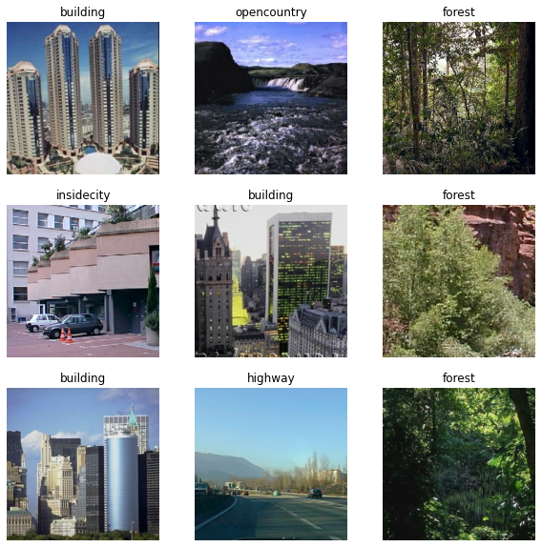
Dataset
Scene classification
Eight classes
Building
Mountain
Street
Forest
Coast
Forest
Inside city
Open country
2500 Image (256*256)

Slide 5
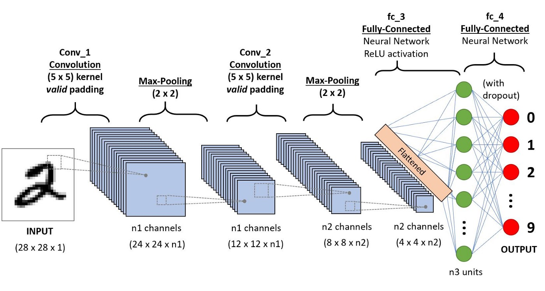
Convolutional Neural Networks (CNN)
Layers
Convolution layers
Extracting features based on nearby pixels
Pooling layers
Decreasing Size
Most important models
VGG
GoogLenet (Inception)
ResNet

Slide 6
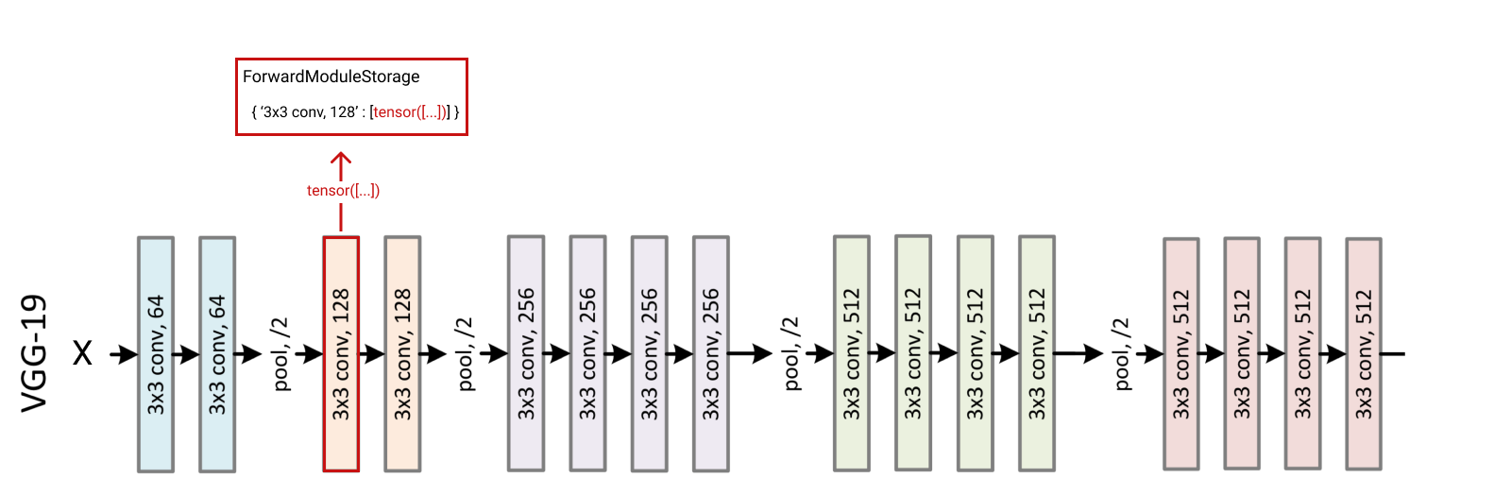
VGG (VGG19)

Slide 7
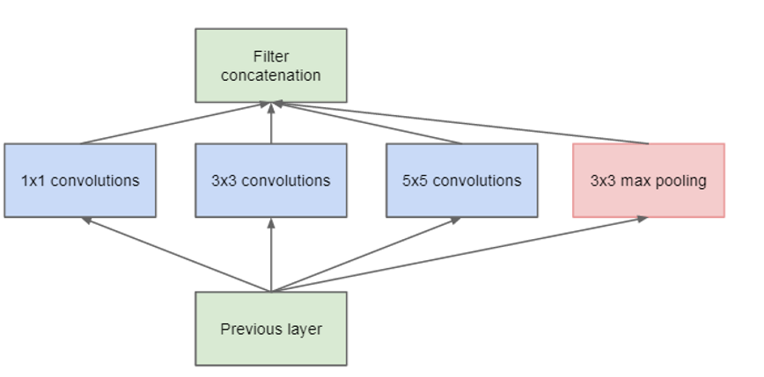
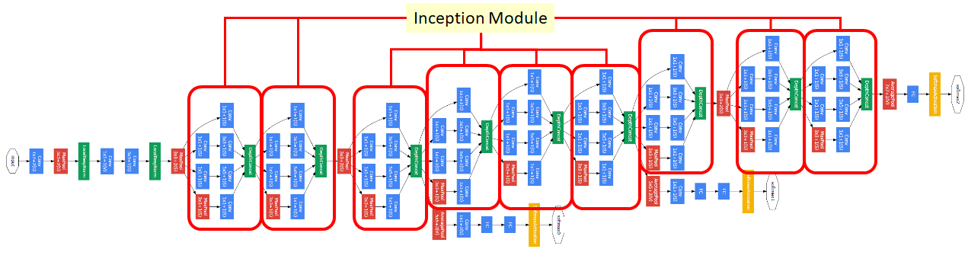
GoogLeNet (Inception)
GoogLenet
Inception Module
Auxiliary Classifier

Slide 8
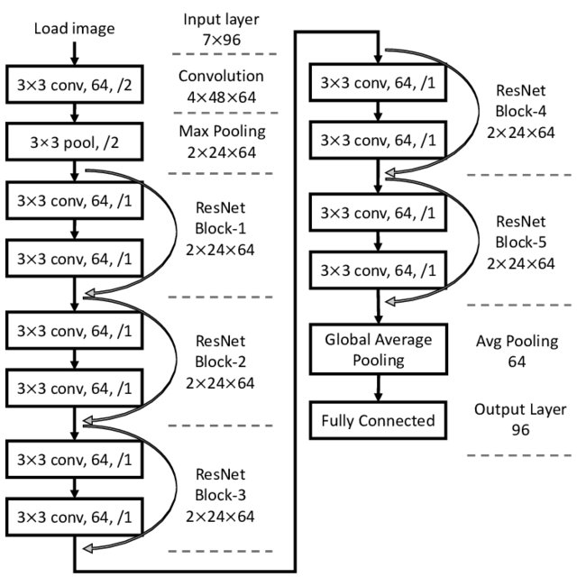
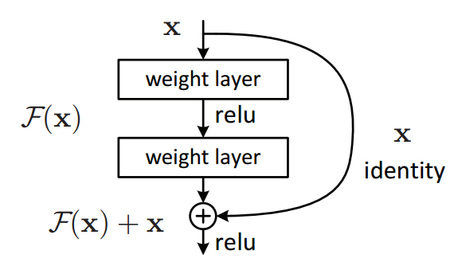
ResNet
ResNet
Residual Blocks
Inception Module

Slide 9
Machine Learning methods
Advantages
Higher speed
Fewer data needed
Sometimes better performance
Most important models
Naïve Bayes
Decision Tree
SVM

Slide 10
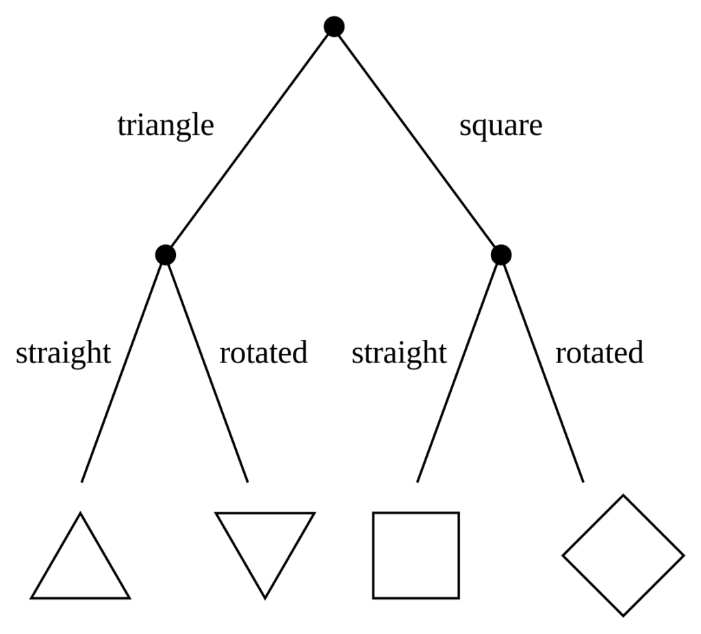
Decision Tree
Advantages
Feature selection

Slide 11
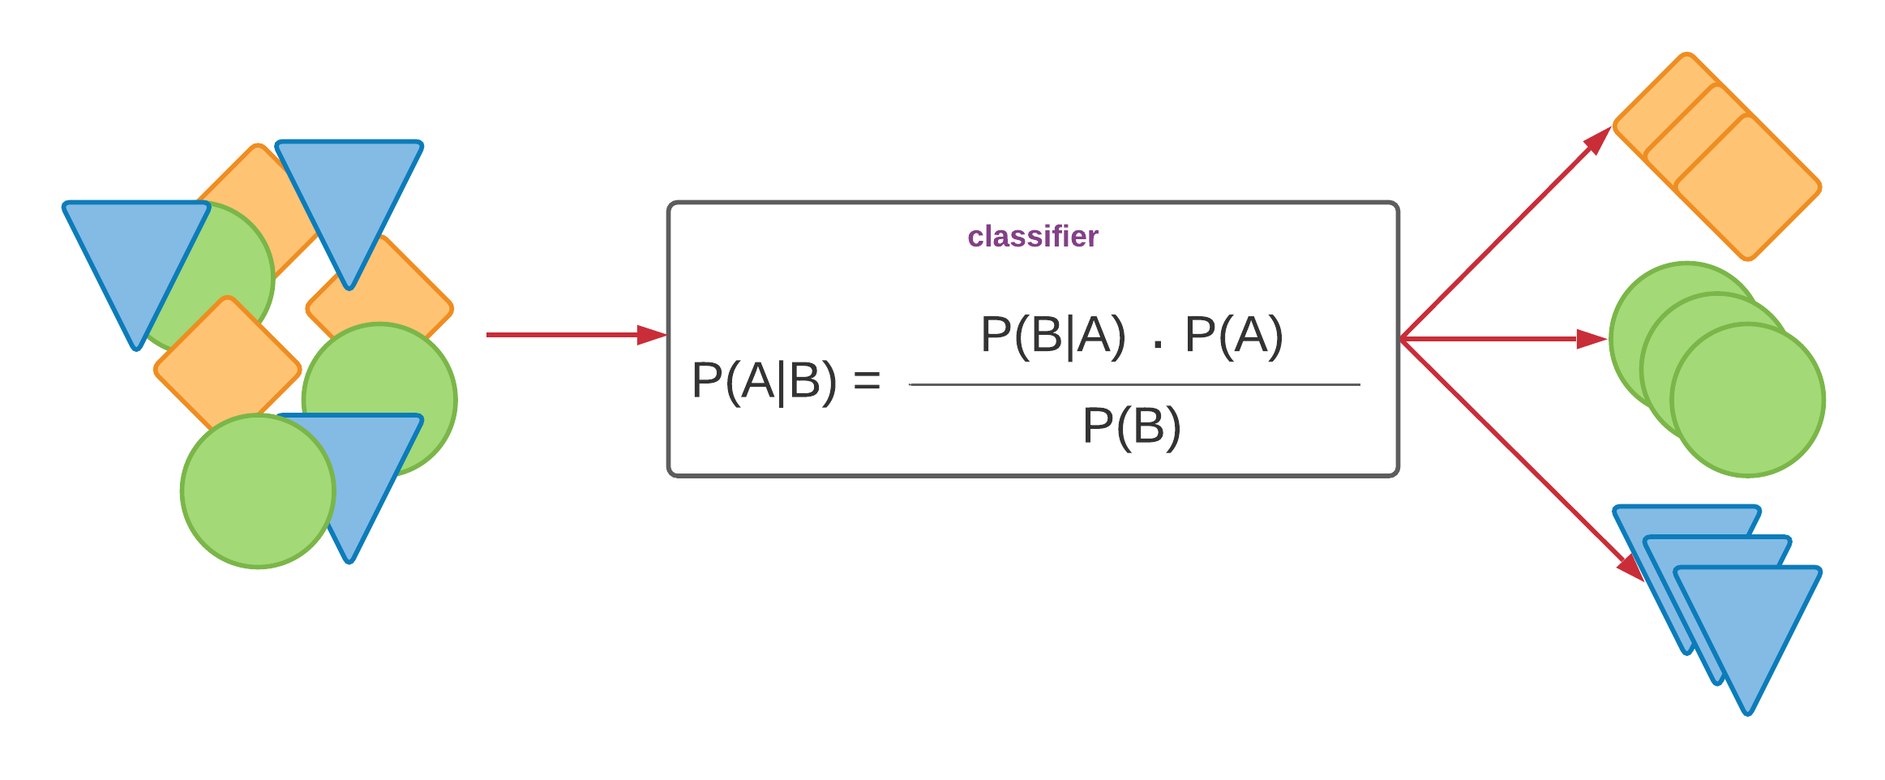
Naïve Bayes
Advantages
Handling missed values

Slide 12
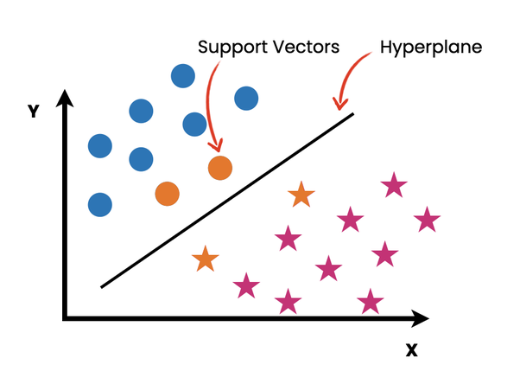
SVM
Advantages
High accuracy on small datasets

Slide 13
Code
Link:
Linkkkkkkkkkk
Dataset ratio:
90-10

Slide 14
Experiments
SVM
VGG (VGG19) | GoogLeNet (Inception V3) | ResNet (ResNet50V2)
0.965 | 0.959 | 0.984 | Train Accuracy
0.940 | 0.921 | 0.919 | Test Accuracy
0.025 | 0.038 | 0.065 | Train and Test Accuracy Subtraction
18.287 | 10.924 | 10.762 | Time for feature extraction
61.030 | 584.174 | 991.545 | Time for model training
79.308 | 595.098 | 1002.307 | Total Time
84.370 | 646.143 | 1090.649 | Time/Test Accuracy

Slide 15
Experiments
Naïve Bayes
VGG (VGG19) | GoogLeNet (Inception V3) | ResNet (ResNet50V2)
0.980 | 0.896 | 0.999 | Train Accuracy
0.578 | 0.783 | 0.694 | Test Accuracy
0.402 | 0.113 | 0.305 | Train and Test Accuracy Subtraction
18.287 | 10.924 | 10.762 | Time for feature extraction
1.419 | 1.618 | 2.134 | Time for model training
19.706 | 12.542 | 12.896 | Total Time
34.093 | 16.017 | 18.582 | Time/Test Accuracy

Slide 16
Experiments
Decision Tree
VGG (VGG19) | GoogLeNet (Inception V3) | ResNet (ResNet50V2)
0.999 | 0.999 | 0.999 | Train Accuracy
0.570 | 0.541 | 0.757 | Test Accuracy
0.429 | 0.458 | 0.242 | Train and Test Accuracy Subtraction
18.287 | 10.924 | 10.762 | Time for feature extraction
32.297 | 97.040 | 63.038 | Time for model training
50.584 | 107.964 | 73.800 | Total Time
88.743 | 199.563 | 97.490 | Time/Test Accuracy

Slide 17
Experiments
Less specific features (ResNet (ResNet50V2) + Decision Tree)
Stage 3 | Stage 2 | Stage 1
 |  |  | Train Accuracy
 |  |  | Test Accuracy
 |  |  | Train and Test Accuracy Subtraction
 |  |  | Time for feature extraction
 |  |  | Time for model training
 |  |  | Total Time
 |  |  | Time/Test Accuracy

Slide 18
Experiments
Less specific features (GoogLenet (Inception V3) + Naive Bayes)
Stage 4 | Stage 3 | Stage 2 | Stage 1
0.988 | 0.890 | 0.826 | 0.892 | Train Accuracy
0.686 | 0.783 | 0.809 | 0.869 | Test Accuracy
0.302 | 0.107 | 0.017 | 0.023 | Train and Test Accuracy Subtraction
7.088 | 7.191 | 7.878 | 10.771 | Time for feature extraction
1.827 | 0.798 | 0.521 | 0.653 | Time for model training
8.915 | 7.989 | 8.399 | 11.424 | Total Time
12.995 | 10.203 | 10.381 | 13.146 | Time/Test Accuracy

Slide 19
Experiments
Less specific features (ResNet (ResNet50V2) + Decision Tree)
Stage 3 | Stage 2 | Stage 1
0.999 | 0.999 | 0.999 | Train Accuracy
0.675 | 0.555 | 0.242 | Test Accuracy
0.324 | 0.444 | 0.757 | Train and Test Accuracy Subtraction
9.378 | 9.849 | 9.927 | Time for feature extraction
79.872 | 37.515 | 311.422 | Time for model training
89.250 | 47.364 | 321.349 | Total Time
132.222 | 85.340 | 1327.888 | Time/Test Accuracy

Slide 20
Thanks for your (multi head) attention!
Dr.Abdi, IUST, Summer 2022
Presenting by Amirhossein Aminimehr

